Slide 1
HopIn
A
University of Regina Carpool Platform
Jessica • Rida • Rudra • Suhayb • Youssef

Slide 2

WHY – The Problem
University of Regina students and staff face significant daily commuting challenges that impact their schedules and budgets.
Public transit routes can be slow or limited, especially during off-peak hours.
Driving alone means expensive fuel costs and limited parking availability on campus.
Ride-hailing services like Uber are often too costly for regular daily commuting.
Existing carpooling happens informally through social media, making it unreliable and unsafe.

Slide 3
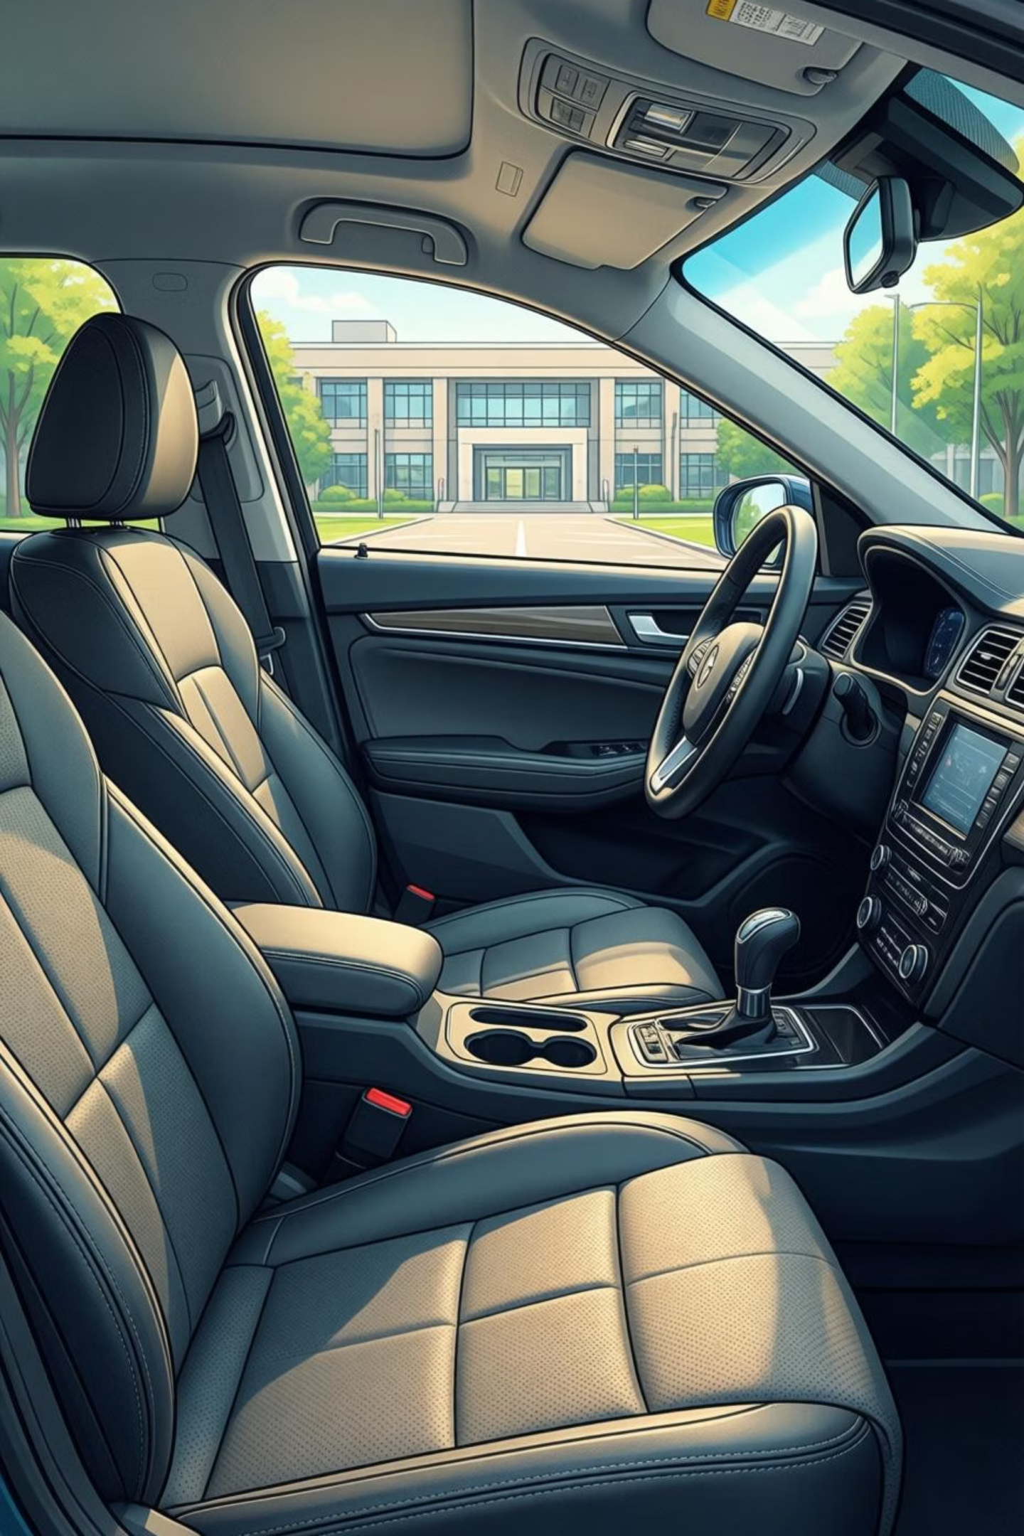
WHY – The Opportunity
Empty Seats
Active Demand
Campus-Focused
Solution
Many drivers travel to campus daily with empty seats that could benefit fellow commuters
Riders are actively searching for affordable and reliable transportation options
A dedicated U of R platform can organise this demand effectively and safely
Triple Benefit
Improves affordability, convenience, and trust for the entire campus community

Slide 4

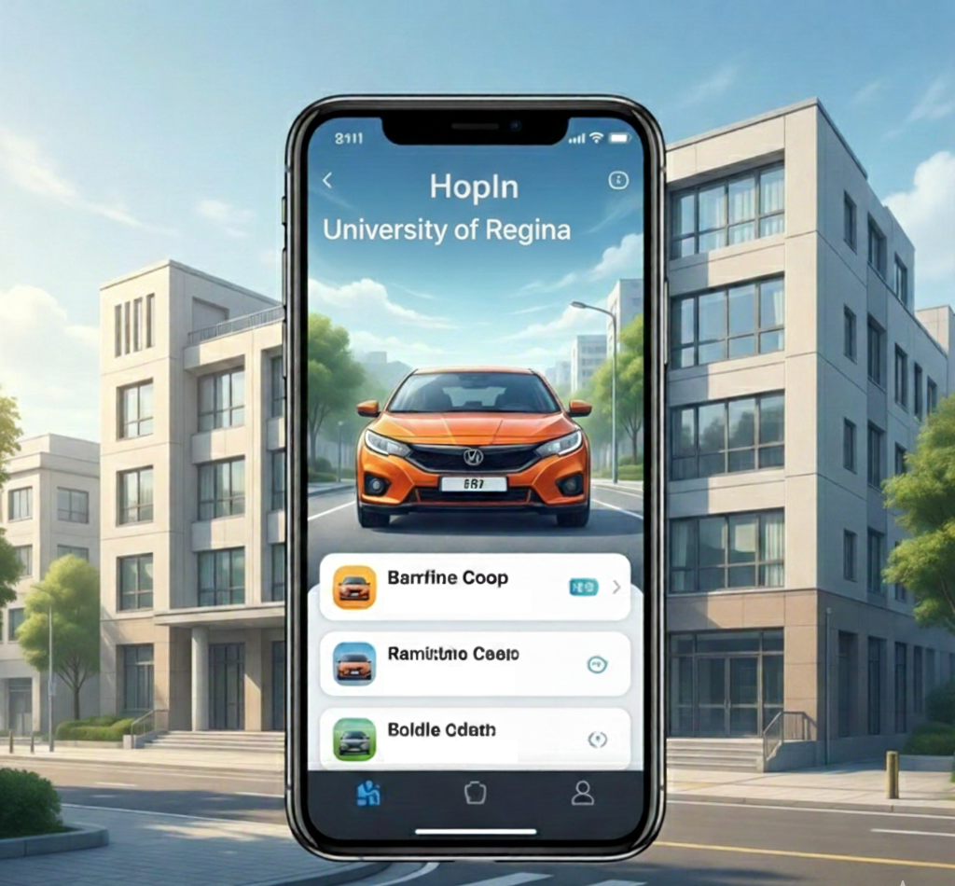
WHAT – HopIn
A University of Regina–specific carpool and ride-sharing web application
Designed to connect drivers and riders traveling to and from campus.
Built exclusively for students, staff, and faculty.
Unlike generic ride-sharing apps, HopIn focuses on safety, accountability and ease of use.

Slide 5

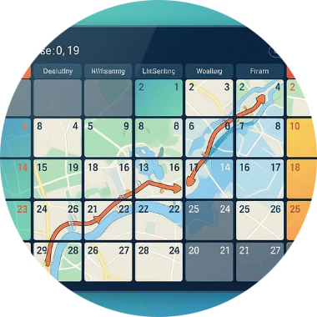
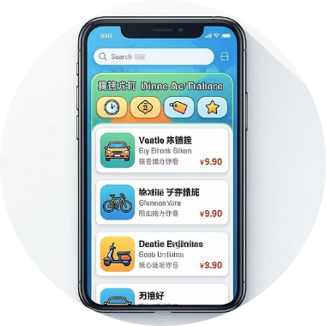


WHAT – Core Features
User Profiles
Ride Posting
Smart Search
Registration with U of R email, detailed driver and rider profiles for transparency
Riders search, compare options, and submit ride requests instantly
Drivers post rides with departure time, price, route, and available seats
Accountability
Driver Verification
Ratings, reporting tools, and drop-off confirmation for accountability
License confirmation and background checks for enhanced passenger security

Slide 6

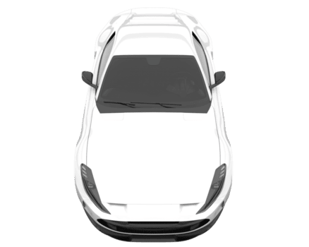
HOW – How HopIn Works
1. Register
Users register with a University of Regina email
Ensures a trusted campus-only community
1
3. Request
2. Post details
2
Riders benefit from transparent pricing and real-time availability
3
Riders browse available rides and submit requests
Drivers post ride details (location, time, price, seats)
Drivers maintain full control over ride acceptance
4
4. Approve
Drivers approve requests and complete trips
5
5. Rate
Both parties leave ratings after the ride
The platform creates a seamless experience from registration to ride completion.
The mutual rating system builds accountability and helps maintain high service standards across the platform

Slide 7
HOW – Technical Approach
1
2
Architecture
Domain Design
Model-View-Controller (MVC) pattern for clean separation of concerns and maintainability
Core entities include User, Ride, Request, and Rating for robust data modeling
3
4
Backend
Frontend
Secure database management for users, rides, transactions, and verification
Intuitive interface for searching, posting, managing rides, and user interactions

Slide 8

Options Considered
Do Nothing
Commuting remains expensive, disorganised, and unsafe through informal channels
Use Existing Platforms
Limited customisation and control, generic features don't serve campus needs
Closed Pilot
Slower growth trajectory, limited initial impact on the broader campus community
Dedicated UoR Platform ✓
Best balance of control, safety, scalability, and campus-specific customisation

Slide 9

Why Build HopIn?
✓
Centralised Solution
One reliable platform replaces scattered social media groups and informal arrangements
✓
Enhanced Safety
University email verification and ratings build trust beyond anonymous social posts
✓
Affordable Access
Cost-effective commuting option that reduces financial burden on students and staff
✓
Future Growth
Scalable model with potential to expand to other universities and institutions

Slide 10

Conclusion
HopIn addresses a real commuting challenge at the University of Regina by providing a safer, more organised, and affordable carpool solution.
Fits perfectly within a 2-month development cycle while demonstrating strong software engineering and project management principles.
This campus-focused platform transforms informal ride-sharing into a trusted, accountable system that benefits the entire U of R community. By connecting drivers with empty seats to riders seeking affordable transportation, HopIn creates value for everyone while building the foundation for future growth beyond our campus.

Slide 11
Thank You!
Any Questions?

